Slide 1
Competitiveness and Diversification Along Key Export Corridors and Investment Climate for Value Chain Development Donald Mmari KNOWLEDGE SHARING ON TRADE AND INVESTMENT “GOOD PRACTICES II”, ACP House, Brussels, Belgium 5th February 2020

Slide 2
Outline
Introduction
Policy Landscape
Good Practice Cases
Constraints to competitiveness
Way Forward

Slide 3
Introduction
Tanzania recorded growth rates averaging 6% per annum since 2005.
Tanzania an attractive trade and investment:
Relative political stability
Strategic geographical location -1,424 km coastline, 8 neighbours
Young, growing population -54.2 million in 2018, 44% <15
Membership to regional trading blocks, EAC and SADC.
Potential for global markets, eg EBA, AGOA, EPA
Main export corridors: Southern, Western, Central, Northern and Zanzibar-Pemba
Notes:
Southern Export Corridor — A largely agricultural corridor focusing on cereals, agroforestry, tea, coffee, pulses and horticulture. Coordinated by among others the Southern Agricultural Growth Corridor of Tanzania (SAGCOT), a Public Private Partnership (PPP) focusing on agriculture and infrastructure. The corridor links the port of Dar es Salaam and other areas in Tanzania with the countries Southern neighbours including Mozambique, Zambia and Malawi. Also used as transit for exports of Zambian Copper.
(ii) Western Export Corridor— Dominated by tobacco, pyrethrum, coffee, cotton, fisheries, agroforestry and minerals. Mainly serves the DR. Congo, Rwanda, Uganda and Burundi
(iii) Central Export Corridor— a logistic hub due to its road and rail network linking other export corridors with the main port of Dar es Salaam. Has limited agriculture potential—nuts, some cereals and grapes— due to its semi-arid climate. Serves similar countries to Western Corridor. Coordinated by the Central Corridor Transit Transport Facilitation Agency (CCTFA)
(iv) Northern Export Corridor—Coffee, tea, horti and floriculture. Links rest of Tanzania to Kenya. Has direct access to the international airport in Kilimanjaro and the Kenyan port of Mombasa
(v) Zanzibar-Pemba Export Corridor—Spices (including cloves) and seaweed. Has potential to expand to natural gas and/oil. Has direct access to the Indian Ocean and close proximity with the international airport.

Slide 4
Introduction-2
Trade
Value of goods exports shows a declining trend since 2016 peak, from $5.6 bn to $4.3 bn in 2018
Value of traditional exports declined faster than non-traditional
Horticultural exports small share, but growing - $33 million in 2018
Imports declined from $ 8.4 bn in 2016 to $8.1 bn in 2018, larger decline in capital goods.
Competitiveness
Ranks poorly in the bottom quintile of WEF’s Global Competitiveness Index at 117/141 countries (116/138 in 2018)
Investment
FDI flow declined markedly from $1.5 bn in 2015 to $755mn in 2016, but gradually increasing ($937 in 2017)
Notes:
Tanzania’s export potential hampered by supply side constraints including: Inadequately coordinated trade and investment policies, poor and unreliable infrastructure, weak education and training, limited access and absorption of technology. These undermine the realisation of recent gains in labour market efficiency, institutional and macroeconomic environment to improve the competitiveness of productive sectors, including agriculture.

Slide 5
Policy Landscape
Current trade policies (2003 for Mainland, 2006 for Zanzibar) and investment policies (1996 for Mainland, 2004 for Zanzibar) under review – seeking to promote competitiveness and diversification-quality, rapid innovation, customization, cost/productivity
DTIS updated: agriculture, mining and extractives and tourism
Trade and investment priorities outlined in FYDP II- industrialization as its main agenda
Recent Government efforts towards value-addition and beneficiation towards improving agricultural productivity and deepening agricultural value chain
National Trade Facilitation Committee – logistics
DTIS updated
Ratified WTO Trade facilitation Agreement
The Blueprint for regulatory reforms to improve business environment
Sector development strategies e.g. leather, cotton, etc
Notes:
In contrast to past trade and investment blueprints, the DTIS discusses concerns on Sanitary and Phytosanitary (SPS), Technical Barrier to Trade (TBT) as well as regulatory and other institutional bottlenecks hindering trade and investment in Mainland Tanzania and Zanzibar

Slide 6
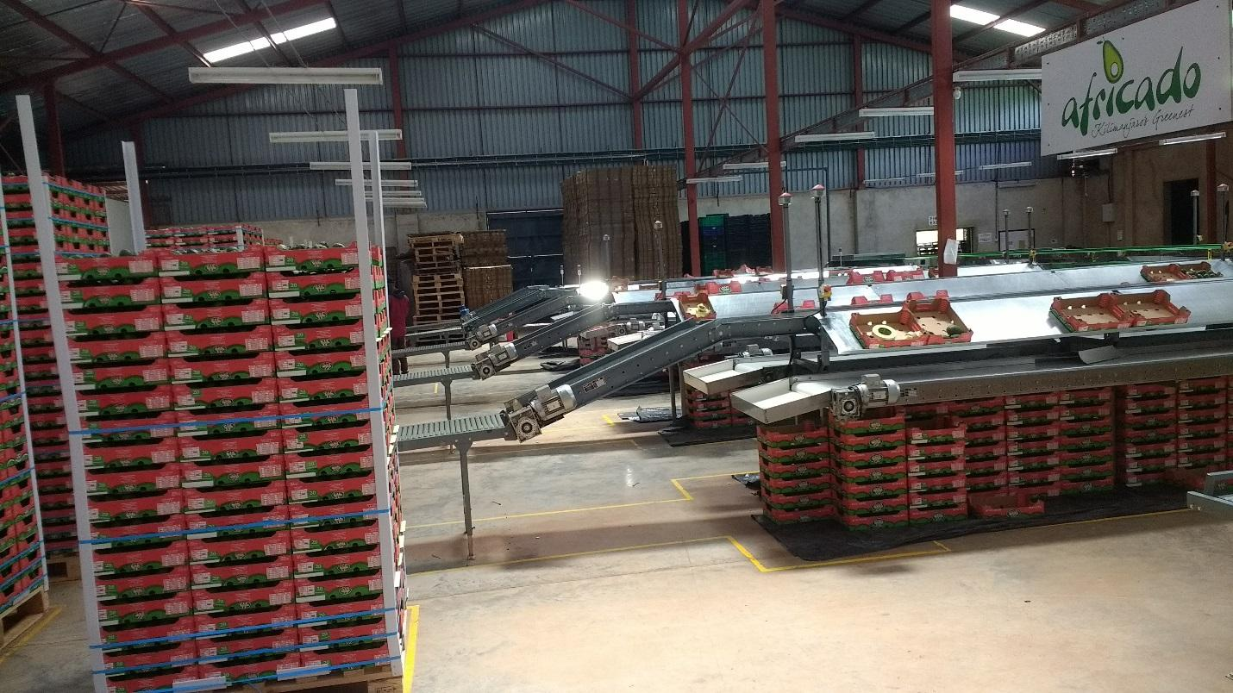
Good Practice Case-1

Slide 7
Good Practice Case-2
AFRICADO COMPANY LTD
The first Tanzanian company exporting avocados (Hass) to the UK- Sainsbury, Tesco supermarkets
Established in 2007, State-of-the-art packhouse facility in 2013
Diversified from poorly performing coffee estate (4,400 tones in 1972 to less than 50 tones in 1990)
Raised competitiveness of AFRICADO’s products, improved quality and access to export markets
Avocado exports from 488 tones in 2012 to 2,579 tones in 2016, a 428.48% increase.
Now designated Export Processing Zone, exporting to UK, France, and Netherlands.
Some small markets in the Middle East

Slide 8
Good Practice Case-3
Smallholder farmers integrated through contractual relations- seeds, extension support, assured markets
Smallholders diversified from reliance on coffee incomes-dramatic declines and fluctuations - now over 2,200 (20% female) out growers
Out grower exports in 2018 – 581 tonnes, nearly 19% of 3,000 tonnes exported (Further expansion targets 8,000 tonnes by 2023)
Investment needed to achieve quality standards and certifications too high for smallholders
Knowledge based transformation of agriculture- the way for the future– but entry costs for small producers entails strategic value chain partnership

Slide 9
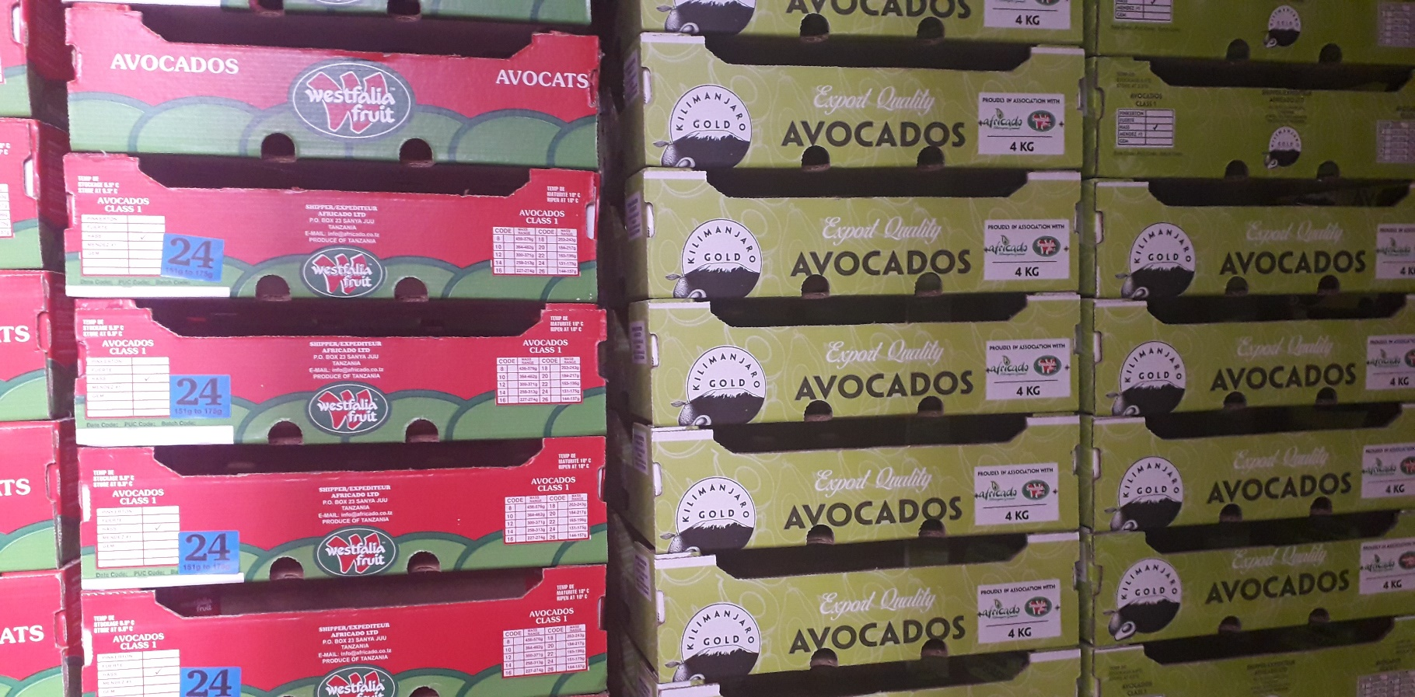
Good Practice Case-4

Slide 10
Constraints to competitiveness
Over regulation- multiplicity of permits and fees, easing with ongoing reforms but more efforts needed
Stringent and costly process of compliance with standards
Quality and costs of logistic services
Other policy and institutional barriers

Slide 11
Way Forward
Policy analysis to support ongoing revision of Tanzania’s trade policy to foster the competitiveness of agro-exports, diversification and value chain development.
TA to address long-standing concerns on agri-trade research—data inconsistencies, M&E systems
Sustainable capacity building to create a critical mass of policy analysts, researchers and trade negotiators
Increased awareness of market needs and compliance by exporters
Informed and continuous dialogue between public and private sectors on trade support and regulations

Slide 12
Thank You for Your Attention!

